Slide 1
NP-Completeness Dr. Tathagata Ray Assistant Professor, BITS Pilani, Hyderabad Campus rayt@hyderabad.bits-pilani.ac.in

Slide 2
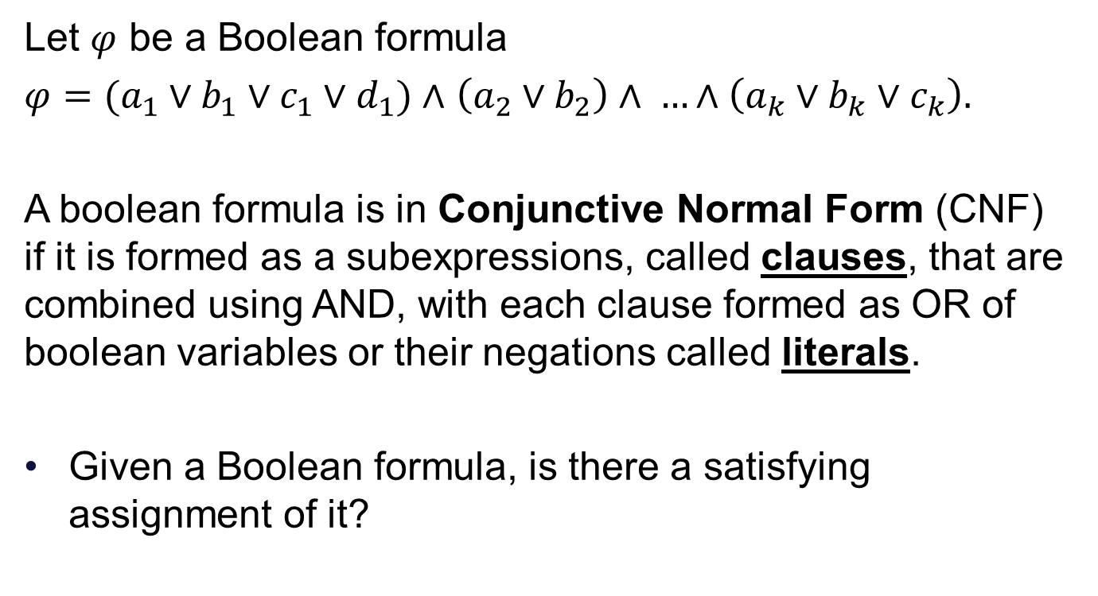
CNF-SAT is NP Complete
Let $φ$ be a Boolean formula
$φ=(a_{1}∨b_{1}∨c_{1}∨d_{1})∧$ $\left(a_{2}∨b_{2}\right)∧ …∧\left(a_{k}∨b_{k}∨c_{k}\right).$
A boolean formula is in Conjunctive Normal Form (CNF) if it is formed as a subexpressions, called clauses, that are combined using AND, with each clause formed as OR of boolean variables or their negations called literals.
Given a Boolean formula, is there a satisfying assignment of it?

Slide 3
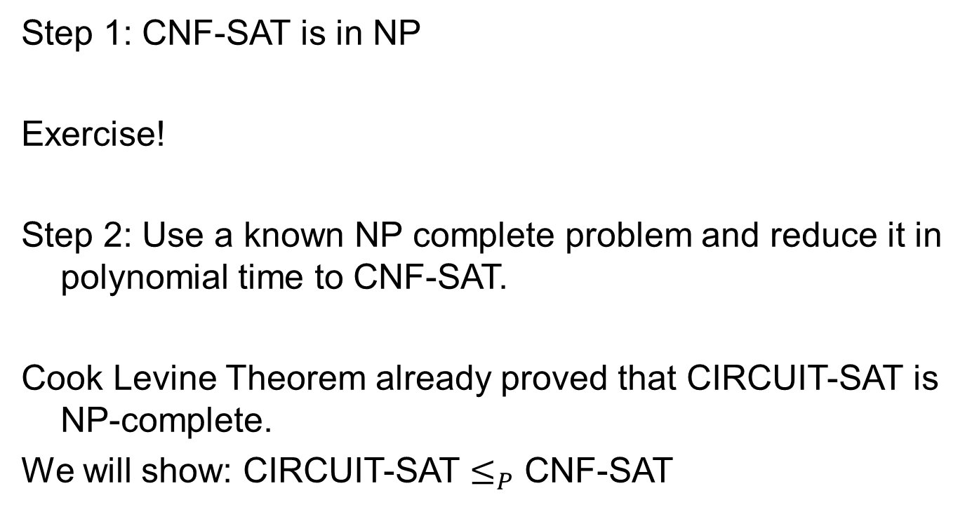
Steps
Step 1: CNF-SAT is in NP
Exercise!
Step 2: Use a known NP complete problem and reduce it in polynomial time to CNF-SAT.
Cook Levine Theorem already proved that CIRCUIT-SAT is NP-complete.
We will show: CIRCUIT-SAT $≤_{P}$ CNF-SAT

Slide 4
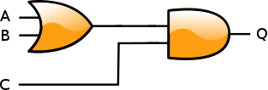
CIRCUIT-SAT
Consider a circuit
Give a variable name to every input and output of all the gates of the circuit
D

Slide 5

Get a corresponding boolean formula
$$(D↔\left(A∨B\right))⋀(Q↔C∧D)$$
This formula is not in CNF.
D

Slide 6
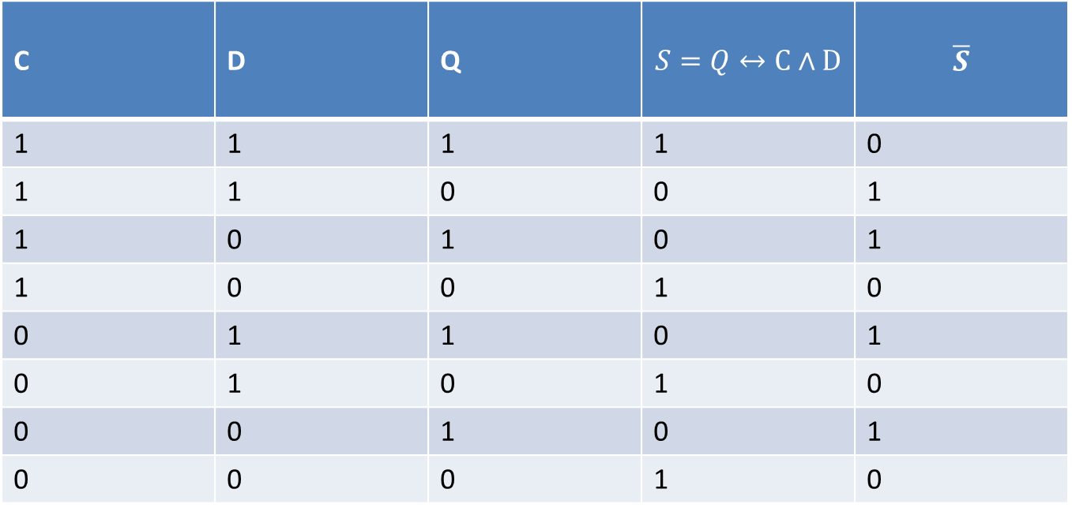
C | D | Q | $$S=Q↔C∧D$$ | $$\overline{S}$$
1 | 1 | 1 | 1 | 0
1 | 1 | 0 | 0 | 1
1 | 0 | 1 | 0 | 1
1 | 0 | 0 | 1 | 0
0 | 1 | 1 | 0 | 1
0 | 1 | 0 | 1 | 0
0 | 0 | 1 | 0 | 1
0 | 0 | 0 | 1 | 0
DNF Formula for $\overline{S}=(C∧D∧\overline{Q})∨(C∧\overline{D}∧Q)∨(\overline{C}∧D∧Q)∨(\overline{C}∧\overline{D}∧Q)$
CNF Formula for $S=(C∨D∨\overline{Q})∧(C∨\overline{D}∨Q)∧(\overline{C}∨D∨Q)∧(\overline{C}∨\overline{D}∨Q)$

Slide 7
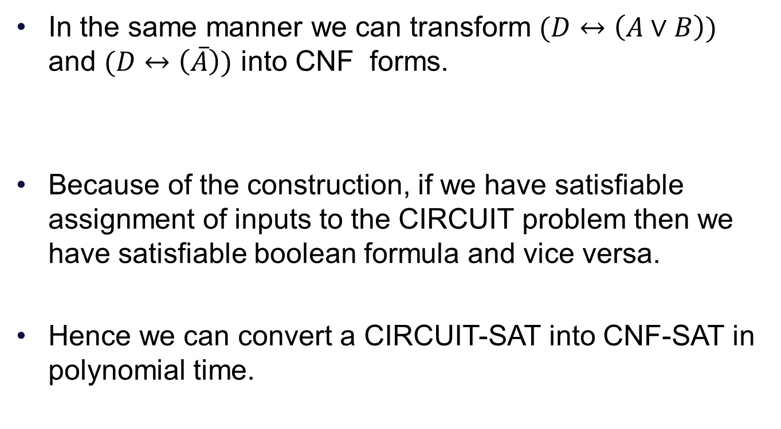
In the same manner we can transform $(D↔\left(A∨B\right))$ and $(D↔\left(\overline{A}\right))$ into CNF forms.
Because of the construction, if we have satisfiable assignment of inputs to the CIRCUIT problem then we have satisfiable boolean formula and vice versa.
Hence we can convert a CIRCUIT-SAT into CNF-SAT in polynomial time.

Slide 8
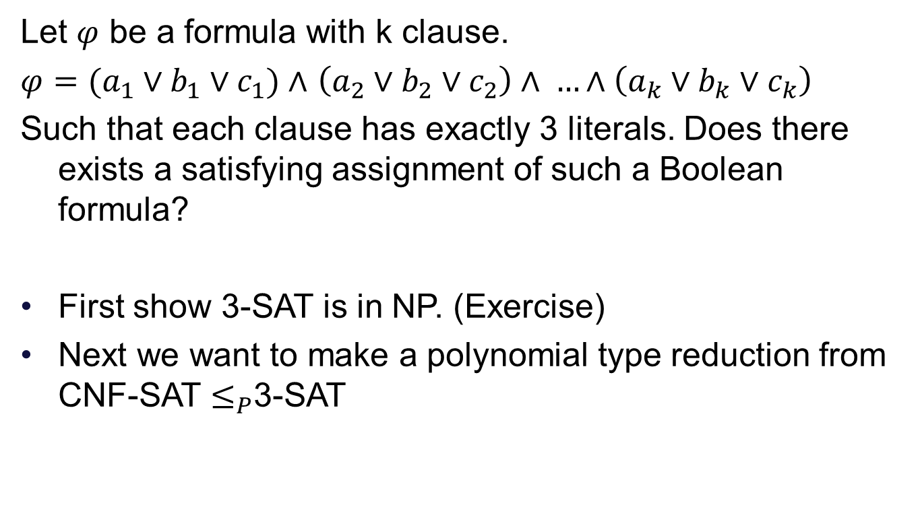
3-SAT is NP-Complete
Let $φ$ be a formula with k clause.
$φ=(a_{1}∨b_{1}∨c_{1})∧$ $\left(a_{2}∨b_{2}∨c_{2}\right)∧ …∧\left(a_{k}∨b_{k}∨c_{k}\right)$
Such that each clause has exactly 3 literals. Does there exists a satisfying assignment of such a Boolean formula?
First show 3-SAT is in NP. (Exercise)
Next we want to make a polynomial type reduction from CNF-SAT $≤_{P}$3-SAT

Slide 9
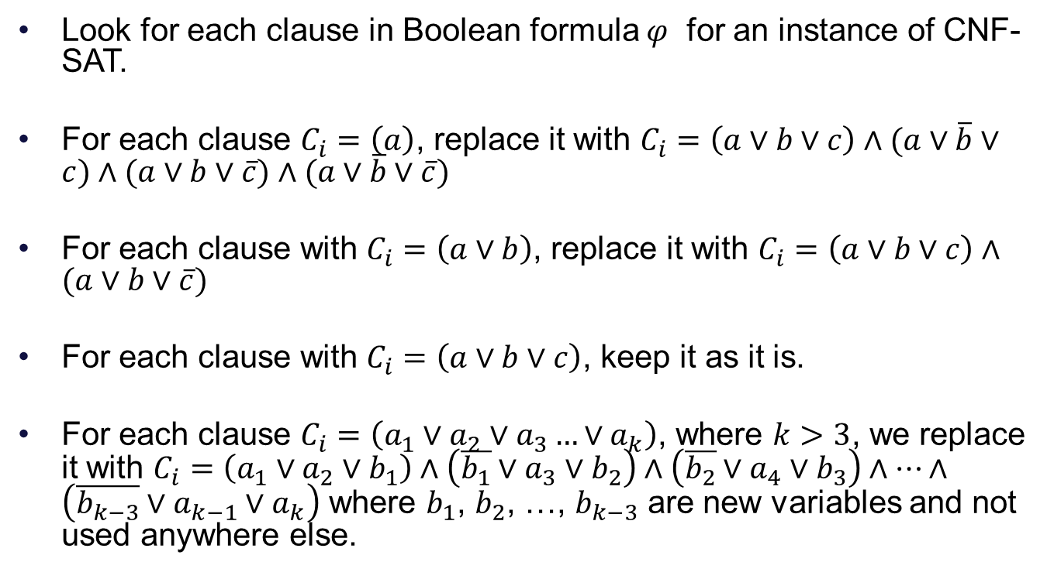
Reduction
Look for each clause in Boolean formula $φ$ for an instance of CNF-SAT.
For each clause $C_{i}=\left(a\right)$, replace it with $C_{i}=\left(a∨b∨c\right)∧(a∨\overline{b}∨c)∧(a∨b∨\overline{c})∧(a∨\overline{b}∨\overline{c})$
For each clause with $C_{i}=\left(a∨b\right)$, replace it with $C_{i}=\left(a∨b∨c\right)∧(a∨b∨\overline{c})$
For each clause with $C_{i}=\left(a∨b∨c\right)$, keep it as it is.
For each clause $C_{i}=\left(a_{1}∨a_{2}∨a_{3}…{∨a}_{k}\right)$, where $k>3$, we replace it with $C_{i}=\left(a_{1}∨a_{2}∨b_{1}\right)∧\left(\overline{b_{1}}∨a_{3}∨b_{2}\right)∧\left(\overline{b_{2}}∨a_{4}∨b_{3}\right)∧…∧$ $\left(\overline{b_{k−3}}∨a_{k−1}∨a_{k}\right)$ where $b_{1}$, $b_{2}$, …, $b_{k−3}$ are new variables and not used anywhere else.

